Slide 1
Prototype & UX, Lo-Fi Wire-framing
TEAM - 5

Slide 2
About our product (Babyshield)
WHAT WE ACTUALLY DO AT BABYSHIELD WELLNESS?
We aim to end all preventable neonatal and maternal deaths in the developing world by building innovative affordable, accessible, highly accurate monitoring solutions for the emerging markets. We use unobtrusive wireless wearable sensors and networks, analytical algorithms and big data as tools to provide continuous, high resolution monitoring and preventive care for every newborn in hospital, and at home-making sure that no stone is unturned to prevent any form of mortality and morbidity . We use design thinking principles to build life-saving technologies that will transform the way healthcare is delivered.

Slide 3
The core issues we are tackling are...
NO TIMELY INTERVETION (Lack of accurate detection of conditions and alerting for timely intervention required to prevent injury)
LACK OF RESOURCES (Early discharge due to lack of family and institutional resources increases the risk)
SKILL INTENSIVE DEVICES (Multiple devices for assesing vital signs are too complex for low skilled healthcare workers.)
FALSE ALARMS (Current devices are expensive with high rate of false alarms.)
DELAYED ATTENTION (In low resource setting, due to lack of manpower, attention to apnea and hypothermia is delayed or absent.)
BULKY DEVICES (Bulky, wired devices that cannot be used during Kangaroo Mother Care and are not portable.)

Slide 4
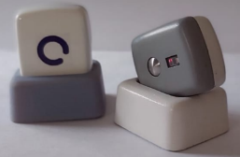
Babyshield wellness device
Our product , the "electronic device" is a wearable on the newborn that continuously monitors the necessary vital parameters used to detect Apnea, Hypothermia and other distress conditions. An integrated diagnostic tool that connects wirelessly to a central platform which ensures that the nurse can monitor all the babies simultaneously and alert when a distress condition is detected. It continuously tracks key vital parameters, detects distress conditions and alerts the caregiver for providing timely intervention and securely stores the data that can be accessed later by the doctor.
Took picture from web as an example

Slide 5
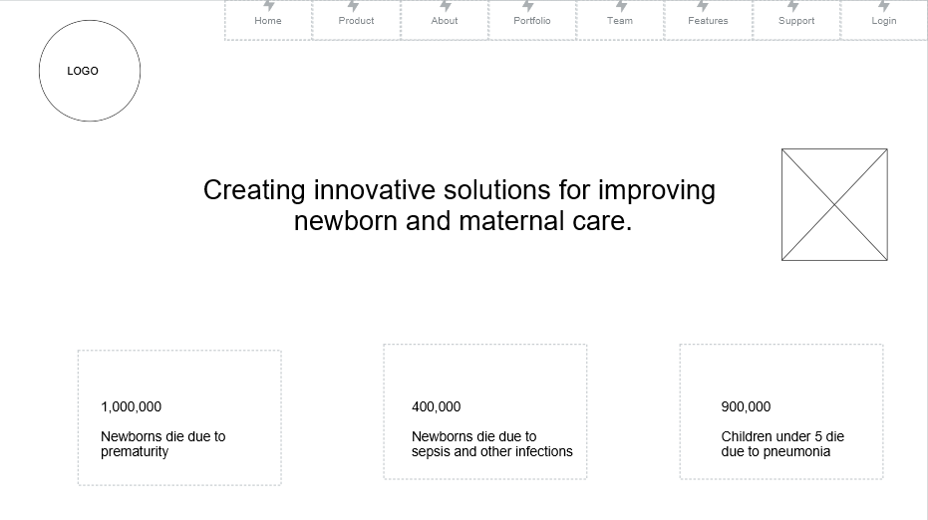
Lo-Fi Wire-framing (Home-page)
This is the homepage where we can see each and every details of our product and ongoing condition of newborn reports.

Slide 6
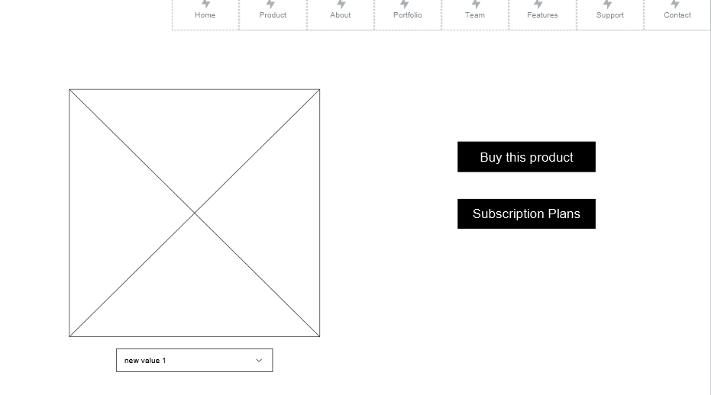
Buying the product/subscribing the plans
From this page customers can buy the product and choose there subscription plans as it is B2B and B2C business both.

Slide 7
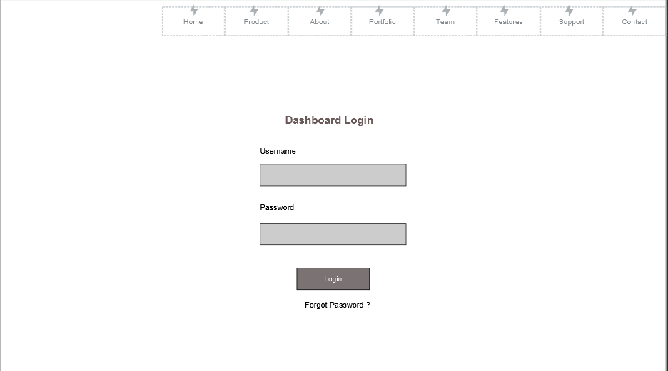
Medical officers login page (doctor’s/nurses)
The dashboard login page is for doctors and nurses only.

Slide 8
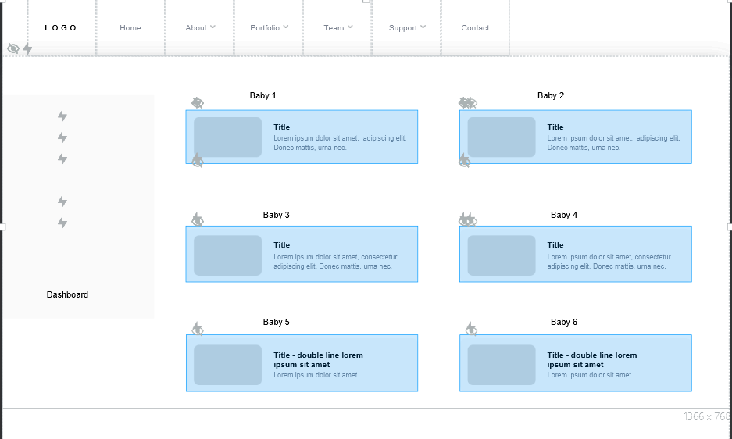
Dashboard monitoring
This is the dashboard where medical officers can see monitoring report of all the babies live on there screen with important notifications like SPO2, Stability, Heartbeat etc.
Real - time high precision monitoring and timely alerting
AI powered Clinical Decision Support System

Slide 9
How Our Product Will Work ?
Hardware Integration: Develop a single piece of hardware capable of measuring multiple vital signs essential for monitoring newborn health. These vital signs may include heart rate, respiratory rate, temperature, blood oxygen saturation, and possibly others.
Real-time Monitoring: The hardware will continuously monitor the newborn's vital signs with high precision in real-time. It will transmit this data wirelessly to a centralized system for analysis.
Alert System: Implement a timely alerting system within the device. This system will trigger alerts if any vital sign falls outside the normal range or if there are any concerning trends, indicating potential health issues.
Hospital and Home Use: Ensure the device is designed to be used both in hospital settings and at home. This versatility allows for continuous monitoring regardless of the newborn's location.
Unified Data Platform: Develop a unified intelligent platform for data management. This platform will receive and store the data collected by the devices, providing a comprehensive overview of the newborn's health status.
Portability and Affordability: Design the device to be truly portable and affordable. Its compact size and affordability ensure accessibility for healthcare facilities of varying resources and can be used during transportation of newborns.
7. Ease of Use: Ensure that the device requires minimal training to operate. Nurses and caregivers should be able to use it effectively without extensive technical knowledge.
8. Remote Monitoring: Enable remote continuous clinical-grade monitoring capabilities. This feature allows healthcare providers to monitor multiple newborns simultaneously from a centralized location, facilitating early intervention when necessary.
9. AI-Powered Decision Support: Implement an AI-powered clinical decision support system within the platform. This system can analyze the collected data, detect patterns, and provide insights or recommendations to healthcare providers for timely intervention or treatment adjustments.

Slide 10
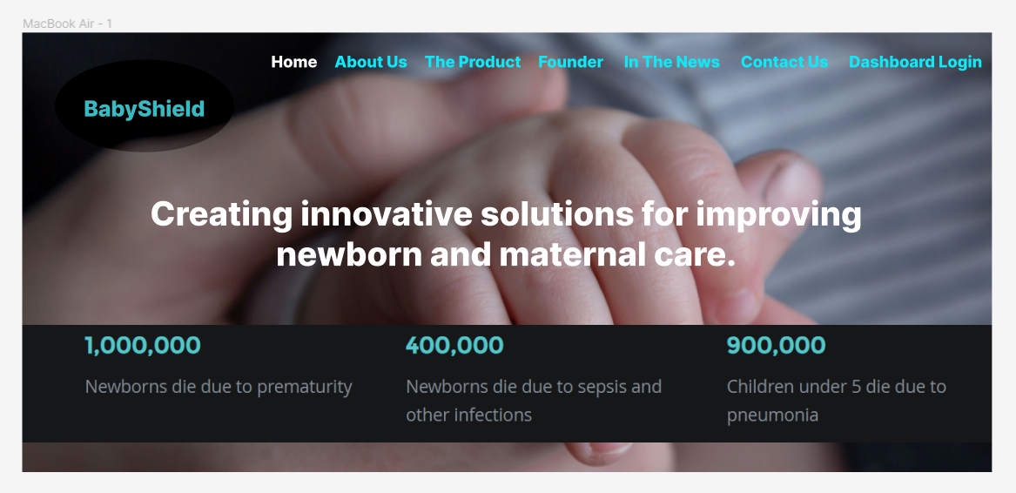
High fi wireframes (homepage)

Slide 11
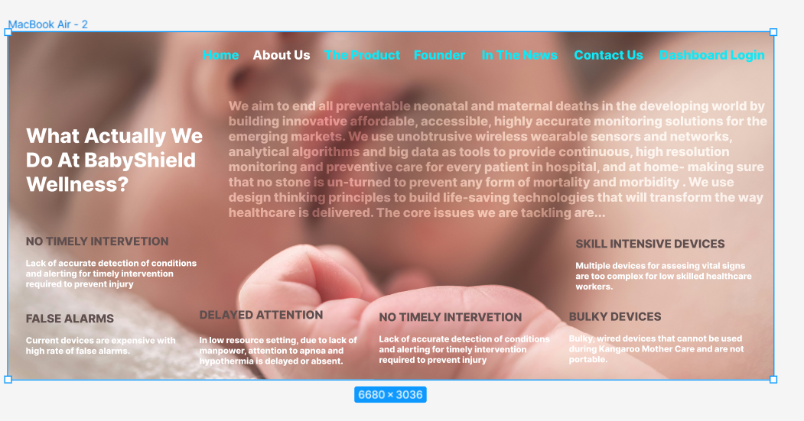
About us page

Slide 12
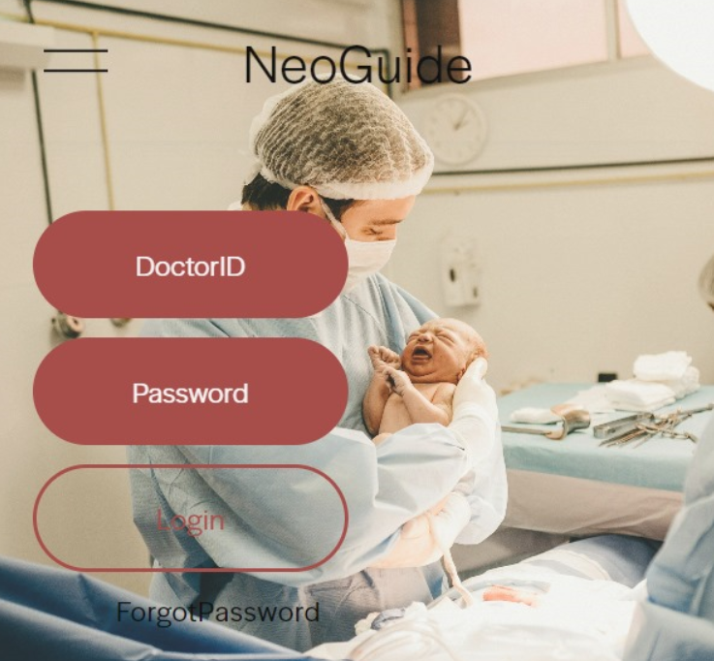
Medical officers login page (doctor’s/nurses)

Slide 13
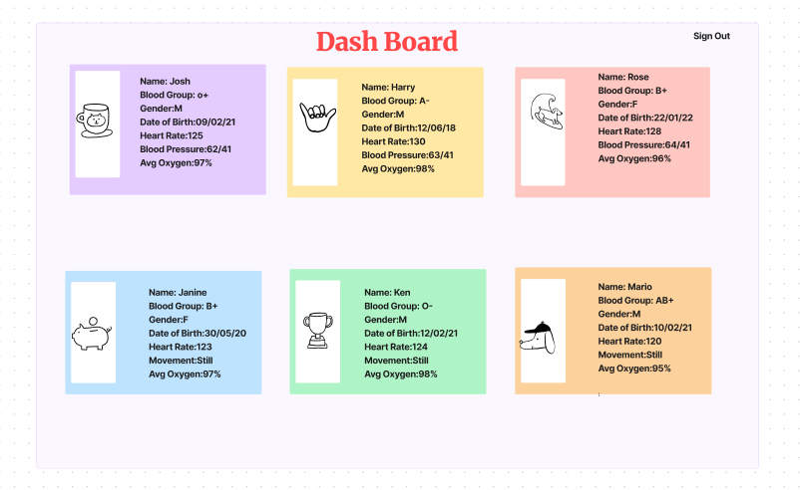
Dashboard monitoring of babies

Slide 14
Thank You.

